Slide 1
Video Game Development

Slide 3
Game Design
Process of designing the content and rules of a game in the pre-production stage and design of gameplay, environment, and storyline during the production stage.

Slide 4
Game development
The software development process where a video game is produced.
This process can take 1-4 years to complete, although some games have take a lot longer

Slide 5
Video Games
A video game is an electronic game that involves interaction with a user interface to generate visual feedback on a platform
Platforms: the electronic systems used to play video games
Examples: personal computers, video game consoles

Slide 6
Why?
As game design continues to develop, it is being incorporated into everyday life

Slide 7
Scratch Video game project
You will be creating a video game using the Scratch software
Needs at least 3 levels
Controls the characters using logical controls
User can win, lose, or end the game and knows when that happens
Four different sounds
Game looks good
Game has clear instructions

Slide 8
 | Scratch Grading Rubric | File name: | Name: Period:
Point Value | 10 | 5 | 0
Start of Game | Green Flag starts/resets objects to correct position and background. | Green Flag starts/resets most objects to correct positions but background incorrect. | Green Flag starts it but does not reset objects or background or is not present
Player Control | User is able to control object(s) from keyboard or mouse using LOGICAL controls and works correctly | Character controlled from keyboard but keys are not simple/logical OR controls work incorrectly | Controls do not work or are not present. Navigation through the program does not make sense
Creativity | Considerable thought went into making the game or story interesting and fun as shown by creative sprite(s), levels, and strategy. | Thought went into make the program interesting, but some of the game elements (sprites, levels, strategy) lacked creativity or made it hard to understand | Game or animation was not interesting or fun to play and elements lacked creativity.
Navigation | User is able to win, lose, or complete the program and it is evident to the player when that occurs. | User is able to win, lose, or complete the program, but it is not evident as to when. | Player is unable to win, lose or complete the program.
Sounds | At least four different sound effects were used effectively with sprites to enhance game-play. | Some sound effects were used, but did not enhance play. | No sound effects were used in the program.
Visual Appearance | There is visual appeal in the program; levels are uncluttered and easy to navigate. | Colors and graphics are somewhat sensible; the program is cluttered and has objects that do not appear to correspond to the objective of the program. | Program is very cluttered, graphics are not sensible, program is not nice to look at.
Text and Instructions | User has a clear understanding of how to play or how to navigate through the program after pressing the Green Flag. Correct spelling is used. | There are direction provided, but not clear to the user. Spelling and grammar errors. | Little or no instructions provided. Lots of spelling and grammar errors.

Slide 9
Website Development

Slide 10
What is it?
The work involved in developing a web site for the Internet or intranet
Mostly the non-design aspects of building websites

Slide 11
Codes
HTML
HyperText Markup Language
Most basic building block of the web, defines the structure of web pages
CSS stylesheets
Describes how HTML elements are to be displayed
Javascript
Object-oriented computer programming language commonly used to create interactive effects with web browsers
C++
Java

Slide 12
Domain name
Unique identifying string that defines a realm of authority or control on the web
Examples:
Google.com
Mskerrtech.weebly.com
Pbs.org

Slide 13
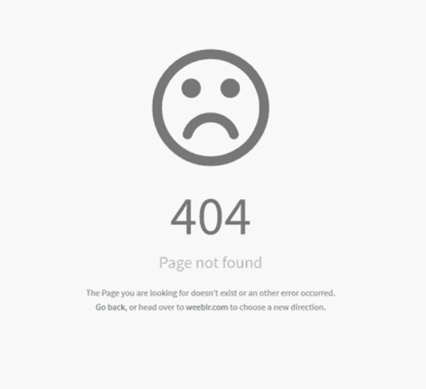
404 Error
What a user sees when they try to reach a non-existent page on your website

Slide 14
Cookies
A small text file which includes an anonymous unique identifier and visit information that is sent to the browser and stored on the visitor’s computer hard drive
Saves passwords – remember me function
Track visits to send targeted ads

Slide 15
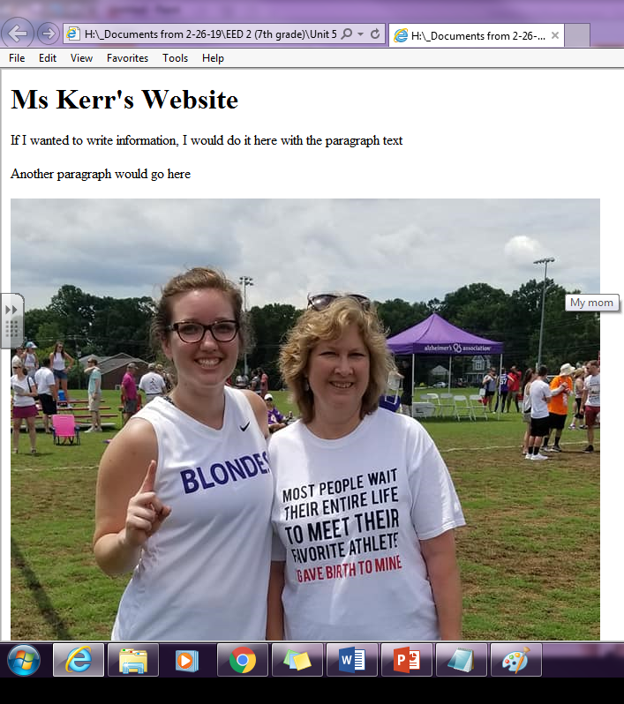
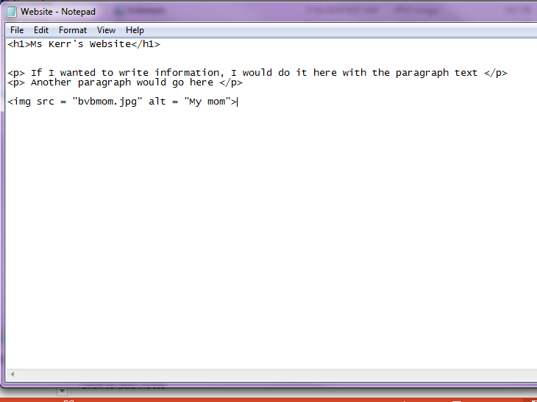
HTML
Notepad
w3schools

Slide 16
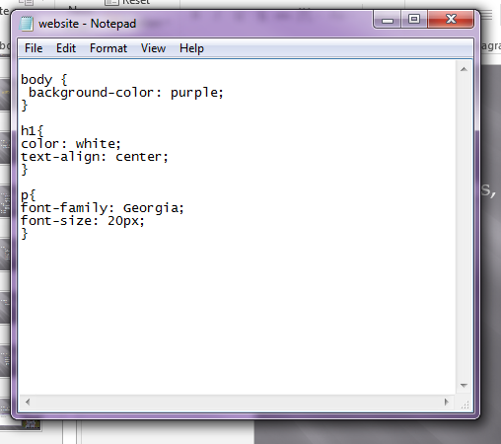
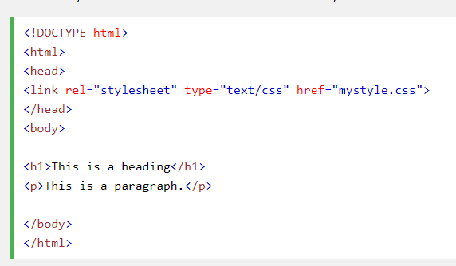
CSS
To change fonts, colors, etc you need a CSS Stylesheet

Slide 17
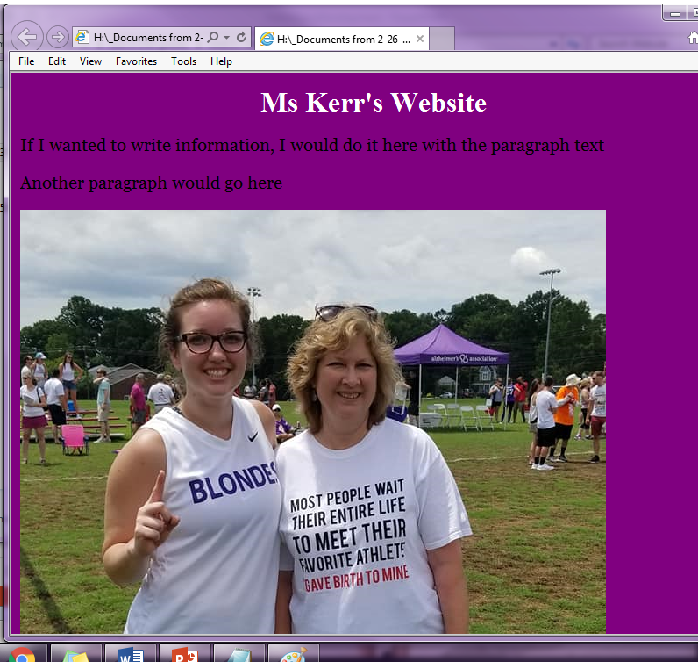

Slide 18
Your job:
Create a website about yourself
Must include:
A homepage for yourself
CSS stylesheet
At least 2 pictures that are important to you
A paragraph about yourself (4 – 6 sentences)

