Slide 1
Unit 4
Green Energy and Sustainability

Slide 2
Nonrenewable energy sources
Petroleum
Propane
Natural Gas
Coal

Slide 3
Green Energy
Energy that comes from natural sources such as sunlight, wind, rain, tides, plants, algae and geothermal heat
They’re renewable
These are also called alternative energy

Slide 4
Solar
Convert the sun’s energy and light into heat, illumination, hot water, and electricity
Homeowners and businesses can use solar energy and often not have to pay a power bill

Slide 5
Wind
Process of creating electricity using the wind

Slide 6
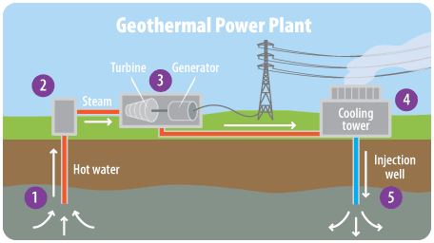
Geothermal
Uses the heat inside the earth to create electricity

Slide 7
Hydroelectric
Uses moving water to create electricity

Slide 8
Bioenergy
Uses plants, animals, and their byproducts to create energy
A landfill can be this type of renewable energy

Slide 9
Nuclear
Uses the energy released during nuclear fission or fusion to create electricity

Slide 10
Activity
Go to my website – mskerrtech.weebly.com
There are 3 interactive videos you need to watch and answer the questions with

Slide 11
Poster Project
Oh No! The Raleigh area is running out of oil! Some of you may feel that this does not directly affect you at this time, but did you realize that your lives are affected by oil everyday -- gasoline prices? Your generation is at great risk from this energy crisis that will affect our lives. The mayor has asked for assistance from the future leaders of tomorrow in developing a solution to this energy crisis. She would like to know what other forms of energy our area could utilize so that we are not dependent on foreign resources. Please begin assisting her immediately! Your city is depending on you!!

Slide 12
You will be assigned to a committee to do research on alternative sources of energy
You have 2 class periods to complete the poster
On the poster you need:
What is your energy and how does it work?
Pros and cons
What NC is already doing with this type of energy
If they do not have it yet, tell me when this might happen OR why this will not happen
What is the cost of this energy source? Daily, yearly? Individual? Home? State?
Does it contribute to any form of pollution? land? water? air? noise? or does it help fix pollution?

Slide 13
Make your Own Wind Turbine
Now that we know about multiple different sources for renewable energy, lets create one!
You will be creating your own wind turbine
Before building, Ms Kerr needs to see your design! Do research if you need to!
Use the materials provided to create it
The turbine cannot be taller or wider than 2 feet
We will test them in class Monday!

Slide 14
City needs poster
If you have any small boxes – cereal box or shoe box size or SMALLER, bring them in!
NO GIANT BOXES
You will be given a technology system and creating a poster about what a city needs from that technology system
Remember a city doesn’t need a cell phone – a city needs cell towers
Think BIG
On your poster:
5 things a CITY needs in your technology system
Pictures of the items
Write 2 – 3 sentences telling me what is in the picture and why the city needs it

Slide 15
Green City Project

