Slide 1
Technology and Systems

Slide 2
Technology
1. Human innovation in action that involves the generation of knowledge and processes to develop systems that solve problems and extend human capabilities.
2. The innovation, change, or modification of the natural environment to satisfy perceived human needs and wants.
Science
The study of the natural world through observation, identification, description, experimental investigation, and theoretical explanations.

Slide 3
Technology solves problems that could not have been solved without it. Technology is:
Not just electronics
Developed out of a want or need
Creative
Constantly changing
Often done in teams
Often an improvement on pre-existing designs
Impacts can be intended or unintended.
Engineers take project ideas developed by technology and design and produce solutions to be used.
Notes:
Reinforce the Engagement and Exploration activities by reminding students that:
Technology is the modification of natural resources and human-made materials to meet human needs or wants and to solve problems that could not be done without technology.
Technology products/artifacts are not just electronics but also everything in society that helps humans to complete everyday tasks, such as combs, shoes, buildings, cars, lights, etc.
Technology is not just products/artifacts but also the actions that humans take to create, invent, and innovate.
Technology exists because humans develop it out of a need or want that must be satisfied (e.g., fire, shelter).
Humans improve technology when needs or wants change or need updating.
Creativity is an asset to technology development.
When technology is able to meet the need or want of humans, that is what makes it creative. Creativity involves being able to find solutions to problems that ordinarily without any brainstorming would be possible to solve. Creativity also involves designing a product that positively impacts society with minimal to no amount of harm caused as of the result of its use (output), its development (processing), or contents used/selected (input).
Technology is often produced in teams because collective ideas have more options and variety than just the one person’s contribution. However, individual ideas alone have often resulted in new products and systems to help solve problems.
Best teaming practices take place when members take turns talking, are considerate of others, and appreciative of others’ ideas.
Technology is often a result to improvements on pre-existing designs.
Have examples ready to share for discussion (e.g., [text needed]).
Remind students to complete “Part II” of Student Resource 1.1.4, “Unit 1 Notes.”

Slide 4
Words You Need to Know
System
A set of related parts - Together, they form a whole, designed to accomplish some purpose
Input
Something put into a system, such as resources, in order to achieve a result.
Process
a series of actions or steps taken in order to achieve a particular end
Notes:
Copy and paste pictures off the internet or scan and paste from print materials.
Include up to date examples as well as historic examples.
Key words to use: greatest innovations of all times - top 100 innovations
After showing examples, have students write and share their own example.
If using one, post words on a Word Wall.
© International Technology Education Assoc
Slide #4
12/01/2009
STEMCenter for Teaching & Learning™ Engineering byDesign™

Slide 5
Words You Need to Know
Output
The results of the operation of any system.
Feedback:
Using all or a portion of the information from the output of a system to regulate or control the inputs or processes or in order to modify the output.
Notes:
Copy and paste pictures off the internet or scan and paste from print materials.
Include up to date examples as well as historic examples.
Key words to use: greatest innovations of all times - top 100 innovations
After showing examples, have students write and share their own example.
If using one, post words on a Word Wall.
© International Technology Education Assoc
Slide #5
12/01/2009
STEMCenter for Teaching & Learning™ Engineering byDesign™

Slide 6
What makes a system?
Input
Processes
Output
Feedback
Notes:
Explain the systems loop, including closed systems (with feedback) and open systems (without feedback). Through discussion, help students to relate the systems model to other systems.

Slide 7
Technology Systems
Agricultural and Related Biotechnologies
Information and Communication Technologies
Developing and using devices and systems to plant, grow, and harvest crops.
Developing and using devices and
systems to gather, process, share
information, and share ideas.
Energy and Power Technologies
Medical Technologies
Developing and using devices and systems to convert, transmit, or process energy.
Developing and using devices and systems to promote health and cure illnesses.
Construction Technologies
Transportation Technologies
Using systems and processes to put structures on the sites where they will be used.
Developing and using devices and systems to move people and cargo from an origin point to a destination.
Manufacturing Technologies
Developing and using devices and systems and processes to convert materials into products in a factory.
Notes:
To help introduce Technology Systems, explain that technology is organized into systems.
These systems help use make sense of the Designed World.
Have students help you brainstorm words that would match with the descriptions.
Explain the systems rarely work by themselves they are dependent on other each other.
Have students name a product and then tell what other technology it depends on. Example - a cell phone depends on manufacturing
Further enhancement of this slide would be to put current pictures of the technology in the empty box.
© International Technology Education Assoc
Slide #7
12/01/2009
STEMCenter for Teaching & Learning™ Engineering byDesign™

Slide 8
Invention and Innovation

Slide 9
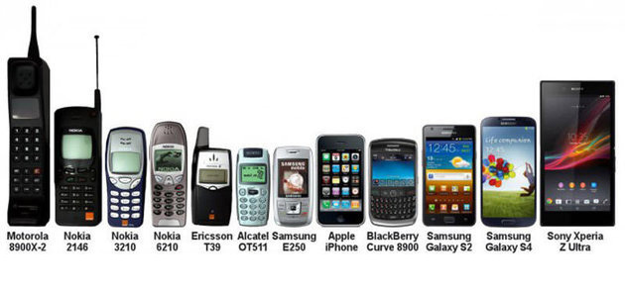
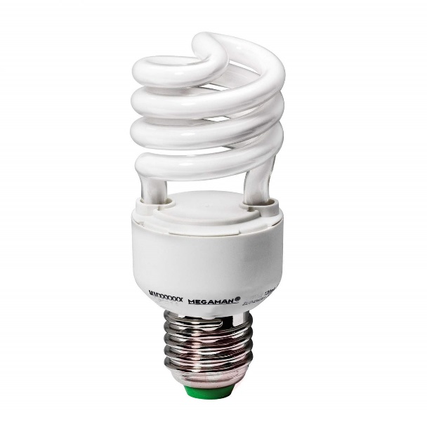
Words to Know
Invention
a process of turning ideas and imagination into devices and systems
Innovation
An improvement of an existing technological product, system, or method of doing something

Slide 10
Criterion
a principle or standard by which something may be judged or decided.
Design brief
A document for a design project developed by a person or team that outlines the deliverables and scope of the project including any products or works (function and aesthetics), timing and budget.
Brainstorming
A term used to describe the process of trying to generate a variety of ideas to meet a particular need or solve a problem

Slide 11
Prototype
The original model of a product or system, used to plan production and troubleshoot problems.
Artifact
a usually simple object (such as a tool or ornament) showing human workmanship or modification as distinguished from a natural object usually remaining from a particular period
Engineering
the branch of science and technology concerned with the design, building, and use of engines, machines, and structures

Slide 12
Technology and Creativity Discussion
How do inventors and innovators arrive at a product or process?
Notes:
© International Technology Education Assoc
Slide #12
12/01/2009
STEMCenter for Teaching & Learning™ Engineering byDesign™

Slide 13
Technology and Creativity Discussion
How do inventors know where to start in the design process?
Notes:
© International Technology Education Assoc
Slide #13
12/01/2009
STEMCenter for Teaching & Learning™ Engineering byDesign™

Slide 14
Technology and Creativity Discussion
How do inventions and creativity influence each other?
Notes:
© International Technology Education Assoc
Slide #14
12/01/2009
STEMCenter for Teaching & Learning™ Engineering byDesign™

Slide 15
Technology and Creativity Discussion
What are some ways to communicate your ideas to another person without using words?
Notes:
© International Technology Education Assoc
Slide #15
12/01/2009
STEMCenter for Teaching & Learning™ Engineering byDesign™

Slide 16
Technology and Creativity Discussion
Describe some inventions that were inspired by a natural object or event.
Notes:
© International Technology Education Assoc
Slide #16
12/01/2009
STEMCenter for Teaching & Learning™ Engineering byDesign™

Slide 17
Technology and Creativity Information
1. Inventions and Innovations are developed to satisfy a need or want.
2. Many inventions or innovations require creativity.
3. Corporations can often create demand for a product by bringing it onto the market and advertising it.
4. Technological ideas are sometimes protected through the process of patenting.
Notes:
© International Technology Education Assoc
Slide #17
12/01/2009
STEMCenter for Teaching & Learning™ Engineering byDesign™

Slide 18
Technology and Creativity Information
5. Communication of your idea is important to everyone that is part of the design team.
6. Marketing a product involves informing consumers about it as well as assisting in selling and distributing it.
7. Marketing a product involves communicating your idea to many people after the product is made.
8. Solving design challenges also requires designers to use mathematical calculations and simulations before actually making an invention. This saves time and money.
Notes:
© International Technology Education Assoc
Slide #18
12/01/2009
STEMCenter for Teaching & Learning™ Engineering byDesign™

Slide 19
Design Brief #1
Design and sketch a detailed drawing of a backpack device that can be used by a physically challenged 7th grader.
Minimal force is needed to open or manipulate the backpack by the physically impaired student.
All dimensions and features should be included in the final presentation.
Notes:
© International Technology Education Assoc
Slide #19
12/01/2009
STEMCenter for Teaching & Learning™ Engineering byDesign™

Slide 20
Great thinkers Activity
Read the stories about the inventions and answer the following questions:
What need or want does the invention satisfy?
What materials were used in the making of the invention?

Slide 21
Design Brief #2
Design a scale model of a homework study table that can be used by a physically challenged 7th grader.
Minimal force is needed for the physically impaired student to approach the table and complete homework.
All dimensions and features should be included in the final presentation.
Notes:
© International Technology Education Assoc
Slide #21
12/01/2009
STEMCenter for Teaching & Learning™ Engineering byDesign™

Slide 22
Inventor Slides Activity
You make work with ONE other person or by yourself.
You are going to look up 3 different inventors. Write 2-3 sentences about the inventor. For each inventor tell me about their inventions (3 – 4 inventions is plenty). Tell me 2 positive and 2 negative impacts of each of the inventions.
Use Google Slides to create this project. Share it with me skerr@wcpss.net
One slide per inventor and invention should be good. That’ll be at least 12 slides.
This is due at the end of class on Tuesday!

