Slide 1
Newspaper Project
Using the disaster you just did all the research on, create a front page of a newspaper from the time it happened.

Slide 2
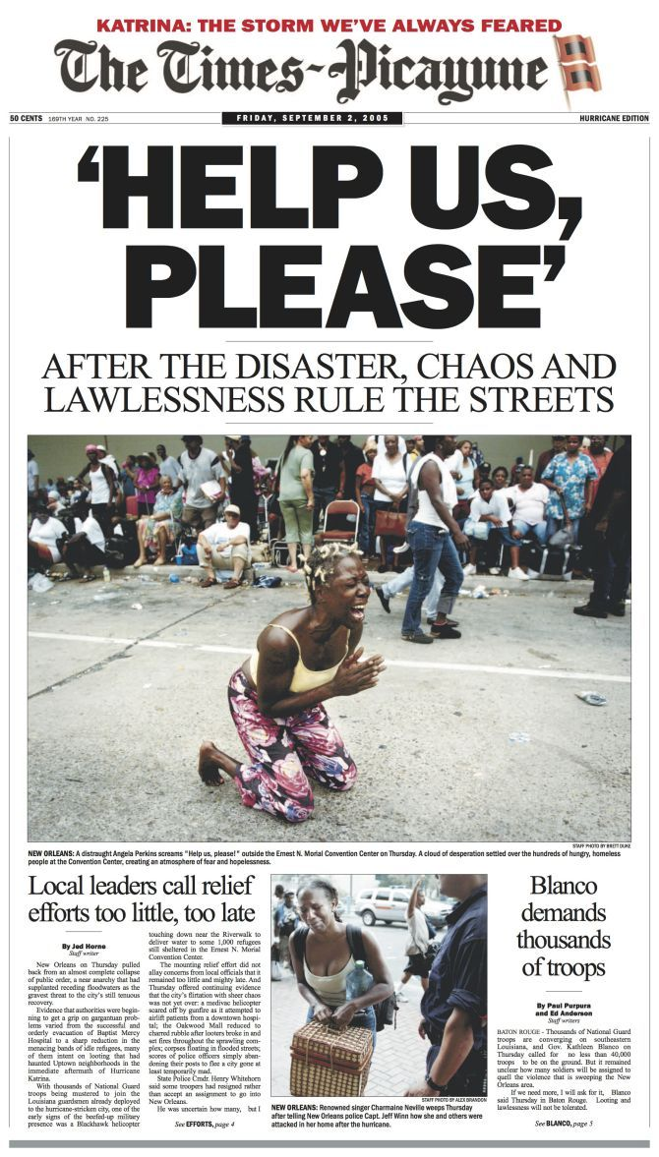
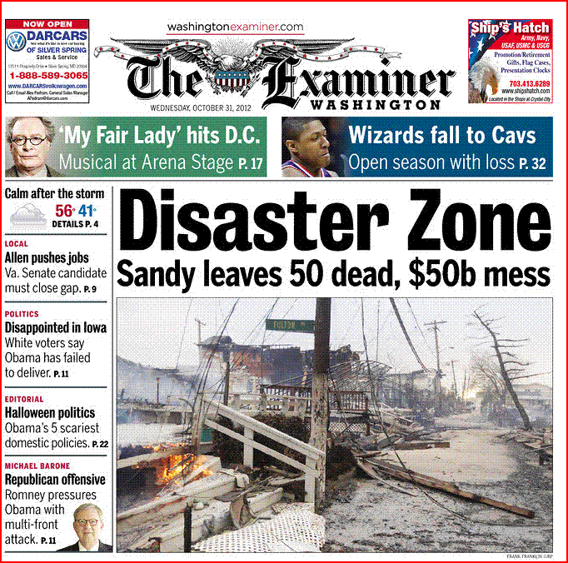

Slide 3
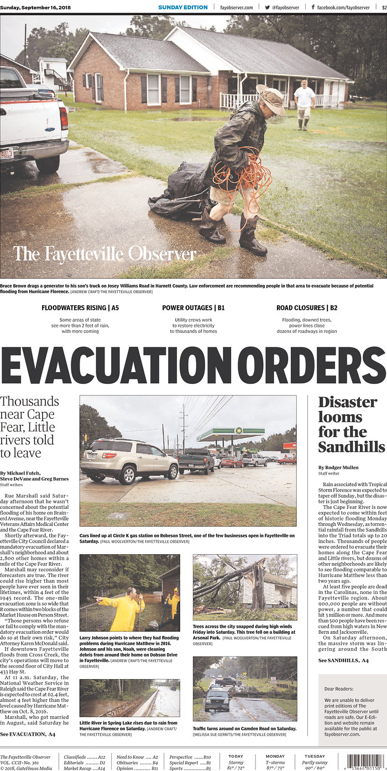
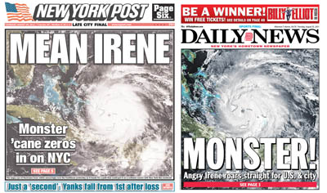

Slide 4
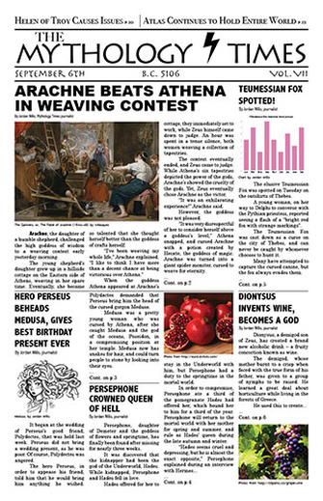

Slide 5
Your job:
A paragraph is 3 – 5 sentences
Create a newspaper front page about your disaster
Your newspaper’s name must be appropriate and original and placed at the top of the front page (ex. London Times, The European Journal, Raleigh Gazette).
Create/Find/Modify at least 3 full color pictures that illustrate some part of the events that you picked
One article must be written that highlights the major significance of your disaster. The article must be at least one paragraph in length and include an appropriate headline.
An opinion section must be included in your newspaper that features someone’s opinion on a significant event connected to your topic. You must write that person’s opinion as if he or she/he lived through the event. It must be one paragraph in length. It can be fictional.

Slide 6
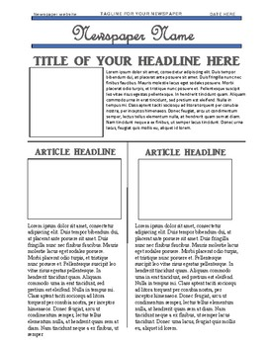
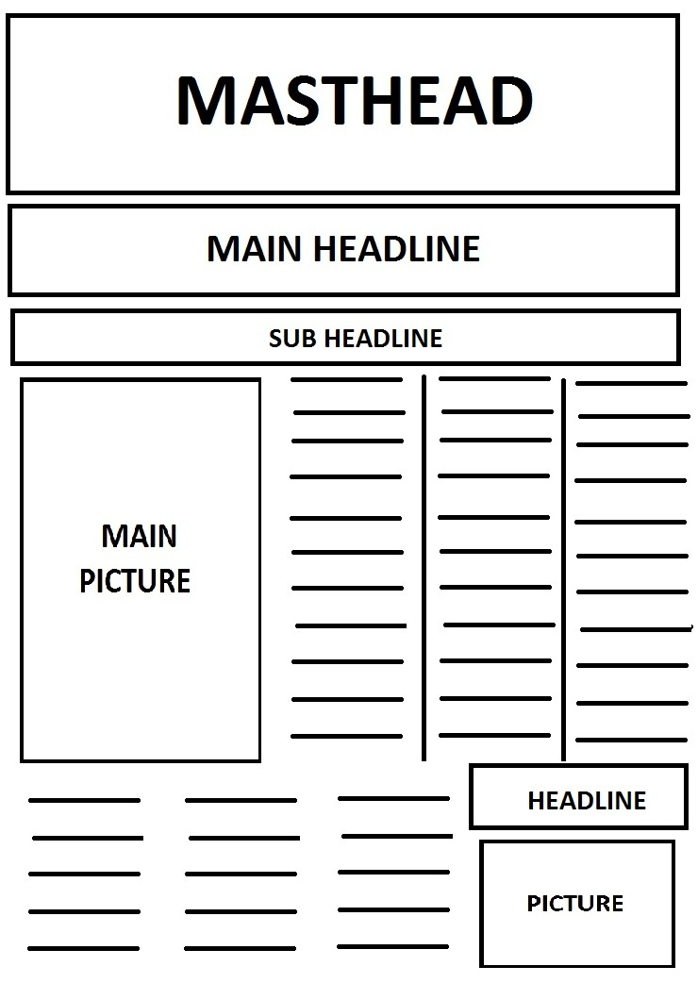

Slide 7
Possible Article topics:
Conditions that cause/lead to their natural disaster occurring
Popular locations (world wide & domestic) for their natural disaster to strike
Historical incidences of their natural disaster
Historical explanation for their natural disaster
Most significant occurrences (biggest, longest lasting, most devastating…)
Recent occurrences
Current technology that can help predict their natural disaster
Health hazards that are a result of their natural disaster striking
Dietary impact of their natural disaster
Economic impact of their natural disaster striking
World wide impact
Humanitarian services that help people in need following a natural disaster

Slide 8
Rubric

