Slide 1
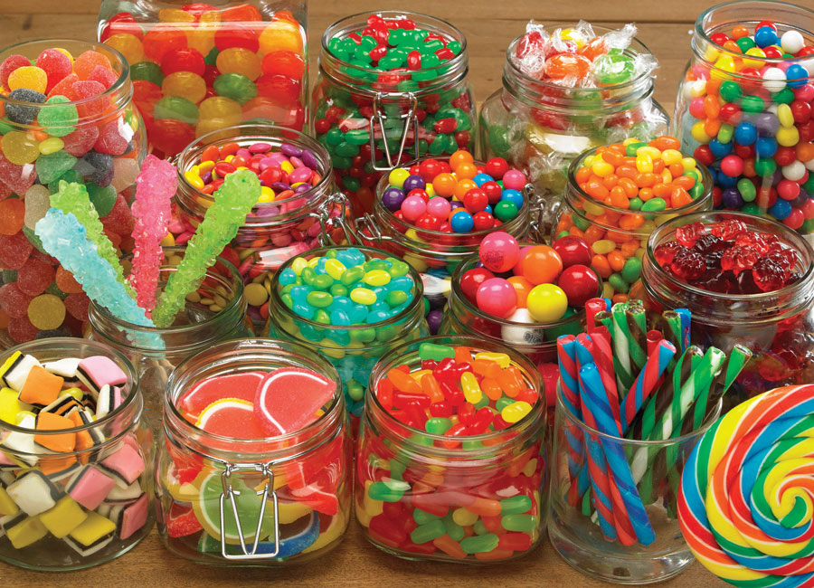
Candy Project
You will be inventing a new kind of Candy and designing a package to help sell this candy.
You will need to detail the process used to make the candy, design the packaging, and create an advertisement to sell your product
This can be a poster, video, electronic presentation, or radio ad
These will be presented on Thursday! Presentations should NOT be more than 5 minutes. Radio ads or video ads should not be more than a minute

Slide 2
Don’t forget….
Make sure to give your candy a creative and fitting name
Make sure to write up the process of how to make it (think in bulk, not in your kitchen at home)
Package design should be bright and eye-catching
Your ad should really make me want to go to the store and buy your candy right then
Presentations should be under 5 minutes and explain the process to make it, show off your package design, and show your advertisement
Presentations are Thursday!

Slide 3
Final Grade _____/80
Candy Project
Candy name (5 points): _________________________ Type of advertisement: __________________________
Candy making Process (20 points):_____
Package design (15 points) _____
Advertisement (30 points) _____
Presentation (10 points) _____

