Slide 1
Unit 5

Slide 2
Words to Know
Motion
Change in position of an object over time
Distance
The amount of separation between two points

Slide 3
Acceleration
The act or process of moving faster or happening more quickly
Inertia
The resistance, of any physical object, to any change in its velocity

Slide 4
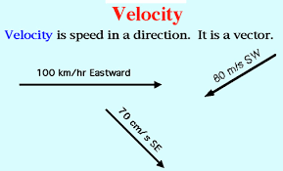
Gravity
the force by which a planet or other body draws objects toward its center
Velocity
The speed of something in a given direction

Slide 5
Speed
The rate at which someone or something is able to move or operate
Friction
the resistance that one surface or object encounters when moving over another

Slide 6
Balanced Forces
Two forces acting in opposite direction on an object and equal in size
Unbalanced Forces
Forces that cause a change in the motion of an object

Slide 8
any of the basic mechanical devices for applying a force

Slide 9
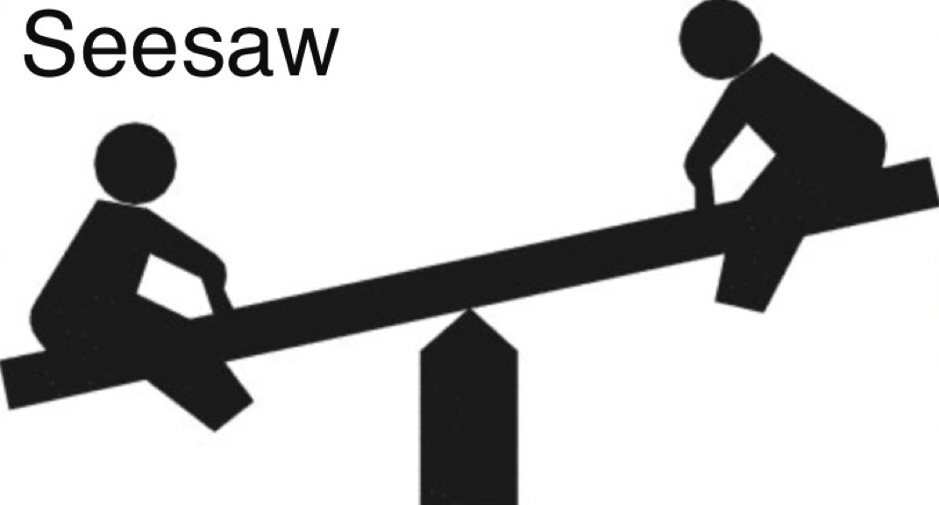
Lever
Rigid bar resting on a pivot; used to help move a heavy or firmly fixed load with one end when pressure is applied to the other

Slide 10
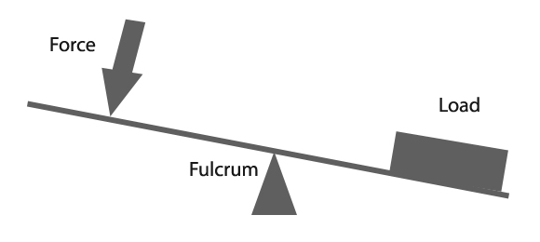
Fulcrum
the point on which a lever rests or is supported and on which it pivots.

Slide 11
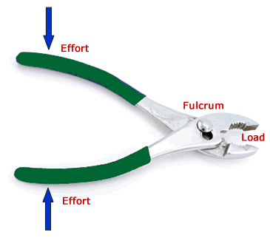
1st Class Lever
fulcrum placed between the effort and load
Examples:
Teeter-totter
Scissors
Pliers
Oars on a boat

Slide 12
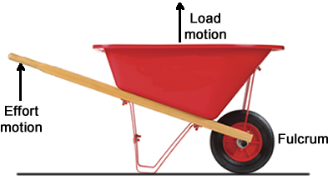
2nd Class Lever
the load is between the effort and the fulcrum
Examples
Wheelbarrow
crowbar

Slide 13
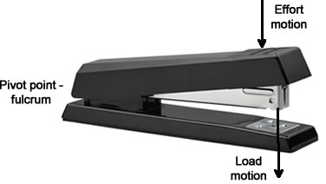
3rd Class Lever
the effort is between the load and the fulcrum
Examples:
Tweezers
Mousetrap
Broom
Stapler

Slide 14
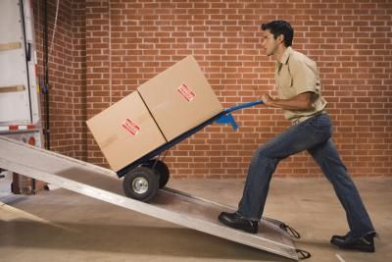
Inclined Plane
A sloping ramp up which heavy loads can be raised by ropes or chains

Slide 15
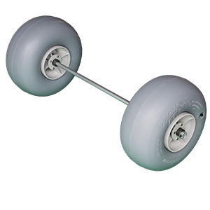
Wheel and Axle
simple machine that uses a wheel with a rod attached in the middle as an axle to help it to lift or move loads

Slide 16
Wedge
a piece of wood, metal, or some other material having one thick end and tapering to a thin edge, that is driven between two objects or parts of an object to secure or separate them.

Slide 17
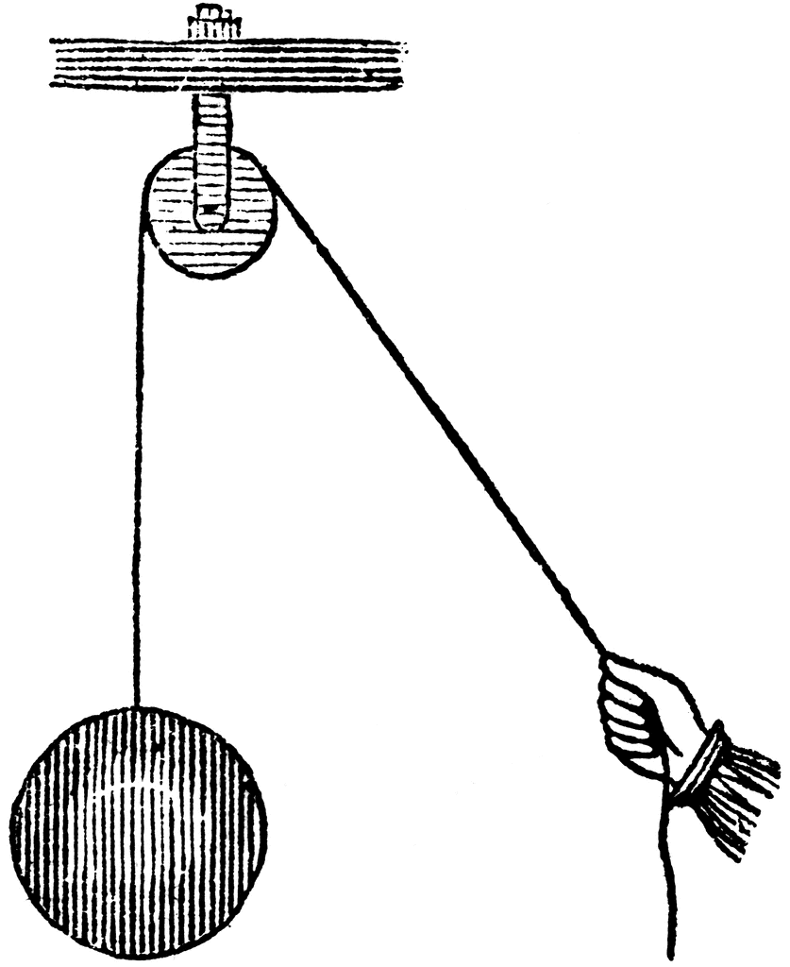
Pulley
a wheel with a grooved rim around which a cord passes. It acts to change the direction of a force applied to the cord and is chiefly used (typically in combination) to raise heavy weights.

Slide 18
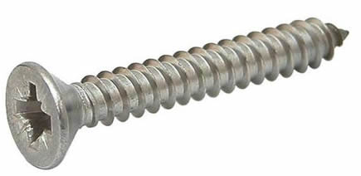
Screw
a short, slender, sharp-pointed metal pin with a raised helical thread running around it and a slotted head, used to join things together by being rotated so that it pierces wood or other material and is held tightly in place.

Slide 19
Mechanical Advantage
The purpose of a machine is to create a mechanical advantage that will facilitate your ability to increase the output for a given input.
There are three types of mechanical advantage:
force, distance and speed.
https://www.youtube.com/watch?v=pfzJ-z5Ij48

Slide 20
Pulley: MA = number of ropes
Wedge: MA = Length of slope/thickness of wedge
Screw: MA = circumference/pitch
Lever: MA = Length to effort/Length to load
Inclined Plane: MA = length of plane/height of plane
Wheel and axle: MA = radius of effort/radius of load
Mechanical Advantage = Output force / input force

Slide 21
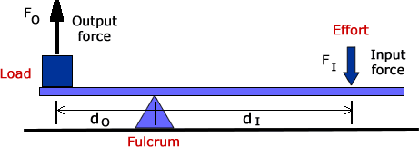
Force Mechanical Advantage
The force mechanical advantage equation is:
MA_{F} = F_{O}/F_{I}
where
MA_{F} is the force mechanical advantage
F_{O} is the output force or load
F_{I} is the input force or effort required to move the object

Slide 22
Distance Mechanical Advantage
The distance mechanical advantage is also:
MA_{D} = d_{O}/d_{I}
where
d_{O} is the distance of the output or load to the fulcrum
d_{I} is the distance of the input or effort to the fulcrum
One good example is when you ride a bicycle. The distance you move the pedals on a bicycle are much less than the distance moved on the circumference of the tires.

Slide 23
Speed Mechanical Advantage
The equation for this is:
MA_{S} = S_{O}/S_{I}
where
MA_{S} is the speed mechanical advantage
S_{O} is the output speed of the load
S_{I} is the input speed of the effort
Example: bicycle
With a bicycle, you pedal at a certain speed, but the different sizes between the pedal sprocket and wheels and the gearing results in you going at a faster speed.

Slide 24
https://www.khanacademy.org/science/physics/work-and-energy/mechanical-advantage/v/introduction-to-mechanical-advantage

Slide 25
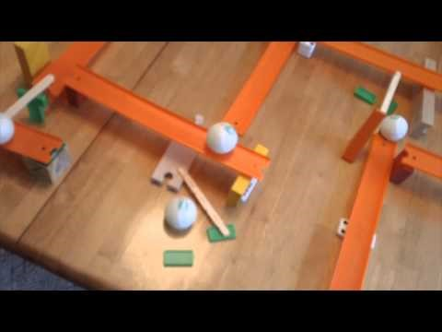
Rube Goldberg Machines

Slide 26
https://www.youtube.com/watch?v=M0jmSsQ5ptw
https://www.youtube.com/watch?v=qybUFnY7Y8w

Slide 27
Rube Goldberg Machine
Goal: To get a marble to move from point A to point B
Constraints:
You can use any of the materials provided
The marble must stop at point B
The marble needs to go through 5 different activities
You cannot touch the marble after it leaves point A

Slide 28
Alternative Transportation
Research and make a list of transportation that uses alternative sources of power to drive the engine (at least 5)
Choose one of those types of transportation and create a poster including the following:
Date of original design
Detailed description of the power source
The number and ways that the original design has been changed or modified
Advantages and disadvantages
You may work with a partner – no groups of 3

